Slide 1

Duration and Portfolio Immunization

Slide 2
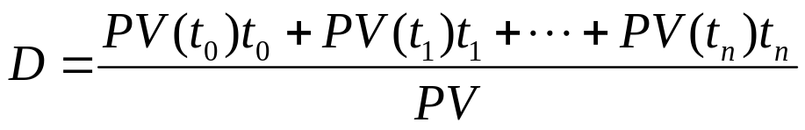
Macaulay duration
The duration of a fixed income instrument is a weighted average of the times that payments (cash flows) are made. The weighting coefficients are the present values of the individual cash flows.
where PV(t) denotes the present value of the cash flow that occurs at time t.
If the present value calculations are based on the bond’s yield, then it is called the Macaulay duration.

Slide 3

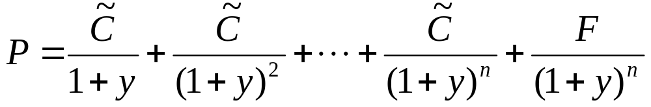
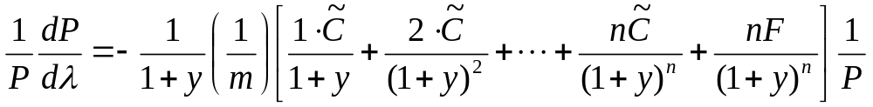
Let P denote the price of a bond with m coupon payments per year; also, let y : yield per each coupon payment period, n : number of coupon payment periods
F: par value paid at maturity
: coupon amount in each coupon payment
Now,
then
Note that λ = my.

Slide 4
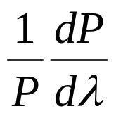
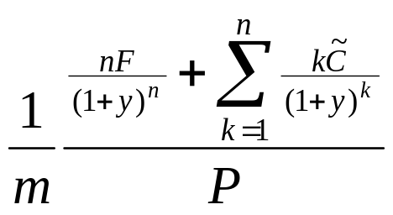
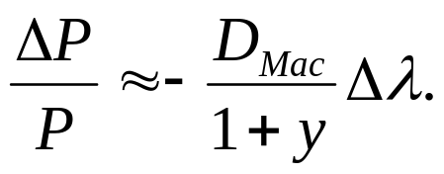
modified duration =
Macaulay duration =
• The negativity of indicates that bond price drops as yield
increases.
• Prices of bonds with longer maturities drop more steeply with
increase of yield.
This is because bonds of longer maturity have longer Macaulay
duration:

Slide 5
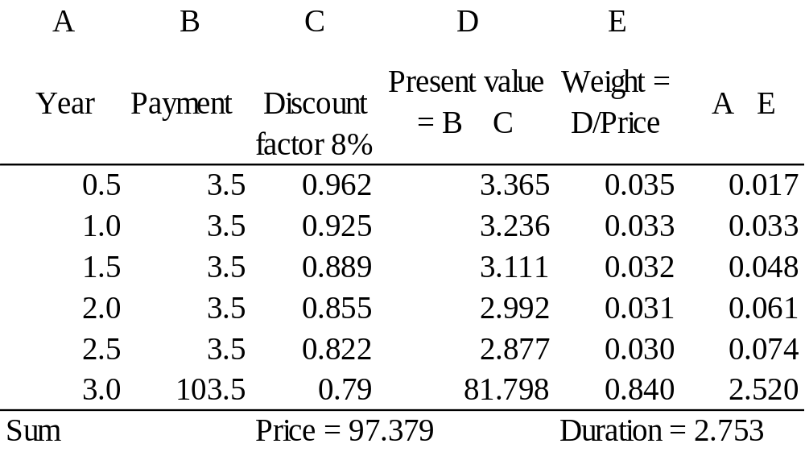
Example
Consider a 7% bond with 3 years to maturity. Assume that the bond
is selling at 8% yield.
×
×
~
Here, λ = 0.08, m = 2, y = 0.04, n = 6, C = 3.5, F = 100.

Slide 6
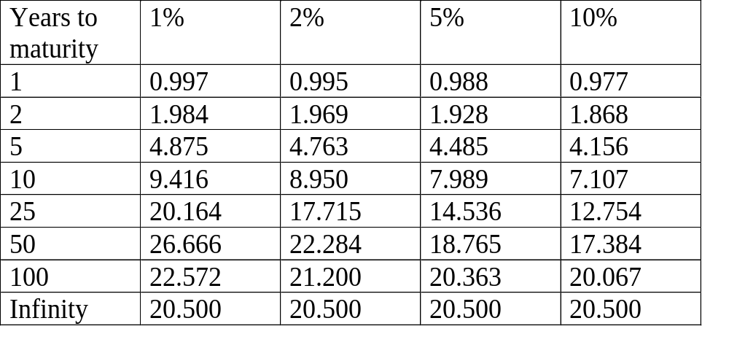
Quatitative properties of duration
Duration of bonds with 5% yield as a function of maturity and coupon rate.
Coupon rate

Slide 7
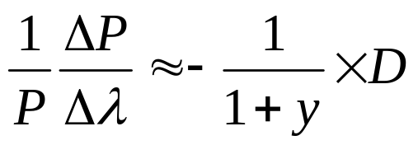
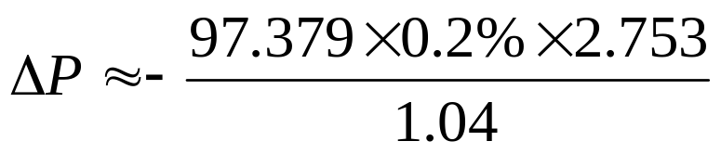
Suppose the yield changes to 8.2%, what is the corresponding change in bond price?
Here, y = 0.04, Δλ = 0.2%, P = 97.379, D = 2.753, m = 2.
The change in bond price is approximated by
i.e.

Slide 8
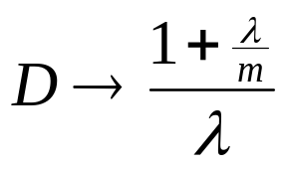
Properties of duration
1. Duration of a coupon paying bond is always less than its maturity. Duration decreases with the increase of coupon rate. Duration equals bond maturity for non-coupon paying bond.
2. As the time to maturity increases to infinity, the duration do not increase to infinity but tend to a finite limit independent of the coupon rate.
Actually, where λ is the yield per annum, and m is the number of coupon payments per year.

Slide 9
Durations are not quite sensitive to increase in coupon
rate (for bonds with fixed yield).
When the coupon rate is lower than the yield, the
duration first increases with maturity to some maximum
value then decreases to the asymptotic limit value.

Slide 10
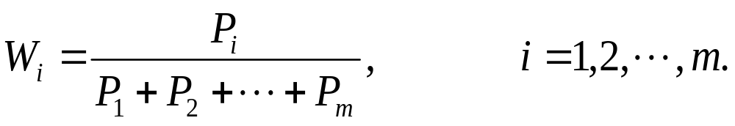
      Duration of a portfolio
Suppose there are m fixed income securities with prices and durations of P_{i} and D_{i}, i = 1,2,…, m, all computed at
a common yield. The portfolio value and portfolio
duration are then given by
P = P₁ + P₂ + … + Pm
D = W₁D₁ + W₂D₂ + … + W_{m}D_{m}
where

Slide 11
        Example
Bond Market value Portfolio weight Duration
A $10 million 0.10 4
B $40 million 0.40 7
C $30 million 0.30 6
D $20 million 0.20 2
Portfolio duration = 0.1× 4 + 0.4 × 7 + 0.3 × 6 + 0.2 × 2
= 5.4.
Roughly speaking, if all the yields affecting the four bonds change by 100 basis points, the portfolio value will change by approximately 5.4%.

Slide 12
Management of bond portfolios
Suppose a corporation faces a series of cash obligations in the future and would like to acquire a portfolio of bonds that it will use to pay these obligations.
Simple solution (may not be feasible in practice)
Purchase a set of zero-coupon bonds that have maturities and face values exactly matching the separate obligations.

Slide 13
Immunization
● If the yields do not change, one may acquire a bond portfolio having a value equal to the present value of the stream of obligations. One can sell part of the portfolio whenever a particular cash obligation is required.
● A better solution requires matching the duration as well as present values of the portfolio and the future cash obligations.
● This process is called immunization (protection against changes in yield). By matching duration, portfolio value and present value of cash obligations will respond identically (to first order approximation) to a change in yield.

Slide 14
Difficulties with immunization procedure
1. It is necessary to rebalance or re-immunize the portfolio from time to time since the duration depends on yield.
2. The immunization method assumes that all yields are equal (not quite realistic to have bonds with different maturities to have the same yield).
3. When the prevailing interest rate changes, it is unlikely that the yields on all bonds all change by the same amount.

Slide 15
Example
Suppose Company A has an obligation to pay $1 million in 10 years. How to invest in bonds now so as to meet the future obligation?
An obvious solution is the purchase of a
simple zero-coupon bond with maturity 10
years.

Slide 16
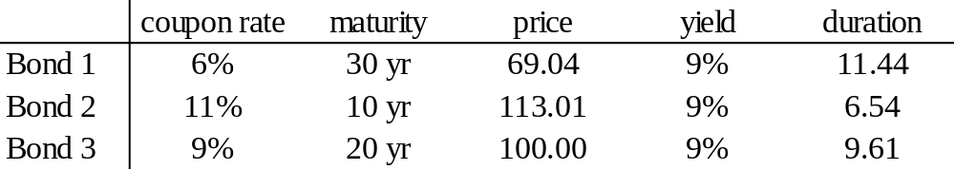
Suppose only the following bonds are available for its choice.
• Present value of obligation at 9% yield is $414,643.
• Since Bonds 2 and 3 have durations shorter than 10 years, it is not
possible to attain a portfolio with duration 10 years using these
two bonds.
Suppose we use Bond 1 and Bond 2 of amounts V₁ & V₂,
V₁ + V₂ = PV
P₁V₁ + D₂V₂ = 10 × PV
giving V₁ = $292,788.64, V₂ = $121,854.78.

Slide 17
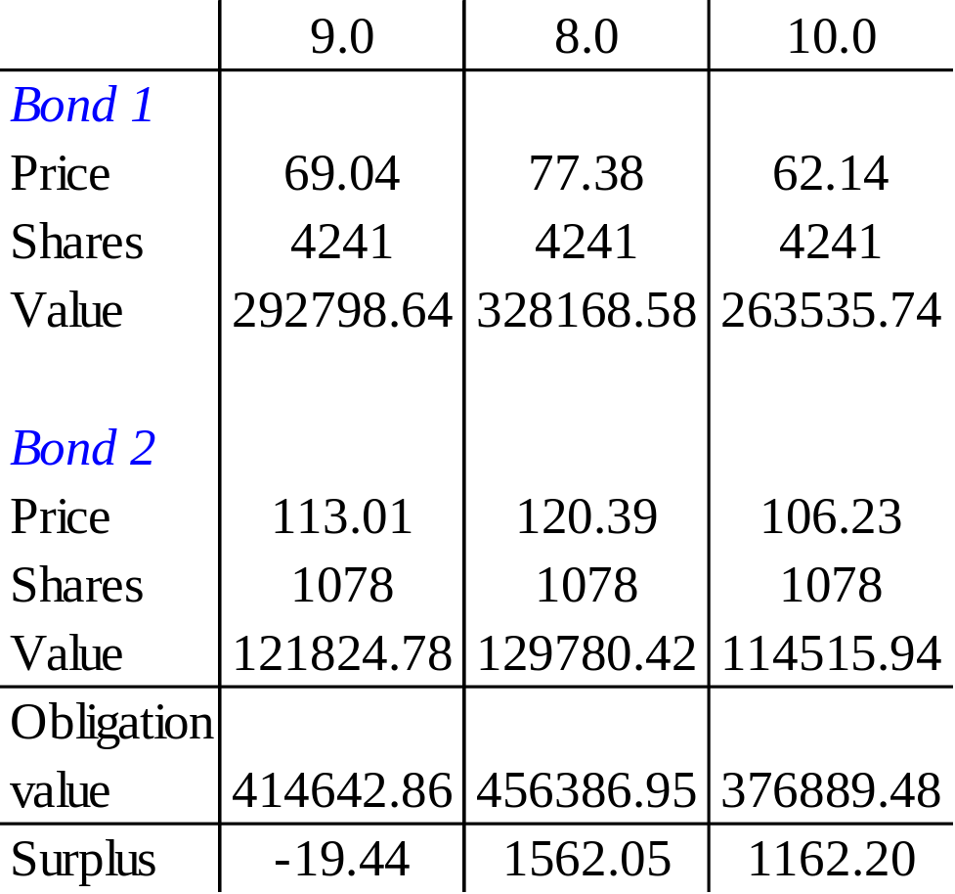
Yield
Observation
At different yields (8% and 10%), the value of the portfolio almost agrees with that of the obligation.

Slide 18
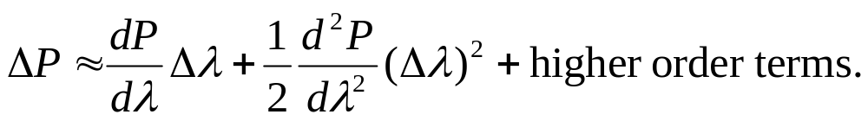
Convexity measure
Taylor series expansion
To first order approximation, the modified duration
measures the percentage price change due to change in yield
Δλ.
Zero convexity
This occurs only when the price yield curve is a straight line.

Slide 19
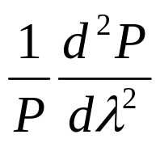
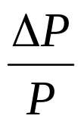
price
error in estimating price
based only on duration
yield
λ
The convexity measure captures the percentage price change
due to the convexity of the price yield curve.
Percentage change in bond price =
≈ modified duration × change in yield
+ convexity measure × (change in yield)²/2

